Slide 1


Keith Tutwiler
5/2/2024

Slide 2

Outline
Executive Summary
Introduction
Methodology
Results
Conclusion
Appendix

Slide 3
Executive Summary
Methodology: To acquire the necessary data, we utilized Python, employing the SpaceX API for primary data collection and the Beautiful Soup library for web scraping and data cleaning. Missing values were addressed to ensure the integrity of our analysis. Subsequently, we conducted an EDA primarily using SQL, supplemented by pandas and Matplotlib for visualizations. Key factors such as flight number, launch site, and booster type were examined to assess their impact on the landing outcome. Furthermore, we employed Folium to create an interactive map of launch sites and developed a Dash application to visualize the proportion of successful and failed launches across different sites. Additionally, we explored the correlation between payload mass and launch success/failure.
Results: Through our analysis, we identified several noteworthy findings:
Successful landing outcomes were influenced by factors such as launch site and booster type.
An interactive map highlighted spatial trends in launch outcomes.
Predictive analysis using KNN, logistic regression, SVM, and decision trees yielded a prediction score of 83%, with minimal false positives.
Orbit type emerged as a significant determinant of launch success, providing insights into optimal trajectories.
3

Slide 4

Introduction
SpaceX is looking for an innovative way to reduce costs and increase efficiency
One way of doing so is reusing stage 1 rockets.
I want to find the key metrics that determine what makes a rocket landing success or not.
This will enable SpaceX to save money by investing in the key factors that make their rockets reusable.

Slide 5

Section 1

Slide 6
Data collection methodology:
My primary method of collecting data involve importing data from the SpaceX API
Also, I scraped the Falcon 9 and Falcon Heavy Launches data from the SpaceX Wiki website
Perform data wrangling
I use the Requests and Beautiful soup library to obtain the web information and parse the data then convert it to a dataframe
Then I was able to calculate the number of Launches at each site and determine their success rate
Perform exploratory data analysis (EDA) using visualization and SQL
Perform interactive visual analytics using Folium and Plotly Dash
Perform predictive analysis using classification models
Afterwards I split the data into training and testing data. I then trained the data using, logistic regression, Support Vector Machines, K nearest Neighbor, and a decision tree.
I used a confusion matrix to help determine the accuracy of the models and used the best_score_ method to determine the accuracy of my models
Methodology

Slide 7
Here is the notebook that covers the entire process
Data Collection – SpaceX API
Import Libaries (requests, pandas, numpy, and datetime)
Defined Functions to extract data from API
Requested Data from the Spacex API(ensured a response)
Created a Dataframe headed by Key metrics
Used the Defined Functions to apply data to Predefined Columns
7
Double checked Data ensure it has no missing or incorrect values.
Saved Data to a local CSV file

Slide 8
Data Collection - Scraping
Import Libraries (requests, BeautifulSoup, etc)
Defined Functions to process html table from API
If you interested In seeing the Step by Step Process you can follow along here
Request the Falcon9 Launch Wiki page from its URL and Create a Beautiful Soup Object
Created a Dataframe headed by Key metrics
Used the Defined Functions to apply data to Predefined Columns
Double checked Data ensure it has no missing or incorrect values.
8
Saved Data to a local CSV file

Slide 9

EDA with Data Visualization
Next, we used a Scatterplot to visualize the correlation between Flight Number and Payload Mass(KG). In the visualization we used a hue to show which launch had successful landings and which one had failures.
Following that I visualized the correlation between Flight Number and Orbit type while also showing hue for successful and failed Launches
Then I visualized the correlation between Paload Mass(kg) and Orbit type while also showing hue for successful and failed Launches
I then showed a comparison of the percentage of Success rate for each orbit type.
Finally, I showed the correlation of Orbit type and Flight Number, also I showed the correlation of Orbit Type and Payload Mass(Kg)
You can see each step here.

Slide 10

EDA with SQL
I then explored the data using SQL
This involved using SQL to display the names of each Launch Site
I displaced the total payload mass carried by boosters launched by NASA (CRS)
Aftwerwards I displayed average payload mass carried by booster version F9 v1.1
Following that I listed the date when the first successful landing outcome in ground pad was achieved.
Then I listed the names of the boosters which have success in drone ship and have payload mass greater than 4000 but less than 6000.
Next, I listed the total number of successful and failure mission outcomes.
Afterwards, I Listed the names of the booster_versions which have carried the maximum payload mass.
Finally I ranked the count of landing outcomes (such as Failure (drone ship) or Success (ground pad)) between the date 2010-06-04 and 2017-03-20, in descending order.
You can follow along here.

Slide 11

Build an Interactive Map with Folium
An interactive map was created to highlight the specific map coordinates the rockets were launched from. The map highlights the successful and failed launches with markers and circles
We then calculated the distances between launch sites and their proximities
This helped determine which launch sites had the best chance of success
To take a look at how this process was performed please click here

Slide 12

Build a Dashboard with Plotly Dash
Here we made two interactive dashboards containing a Pie chart and Scatter Plots using Plotly Dash
With my Pie chart you can see the success/failure proportion for each Launch Site with a drop-down menu
With my Scatter plot you can see the correlation of each Launch Site and the Payload Mass(kg) and a hue the shows the successful or failed launch site.
The Scatter plot is interactive and allows you to select the Payload Mass range preferential analysis
With these plots you help determine with Launch Site had the highest probability of success and which payload ranges had the highest/lowest success rates
You can see the code needed to complete the dash app here

Slide 13
Predictive Analysis (Classification)
Finally, python machine learning models (LR, SVM, Decision Trees, and KNN) were used on the data to make predictions for the launches
First were imported our Libraries and imported the data
Separated the Class column into a prectiction variable (Y)
Took the rest of the columns and assigned to a another variable (X) and standardized it
Split the Data into training and testing
Created a Logistic Regression, Support Vector Machine, Decision Tree, and K nearest Neighbor Objects
Used each object to make a prediction
Calculated a Score foreach model used
Plotted a confusion matrix for each model to visualize the false positives and negatives
Check it out here to see the entire process
13

Slide 14

Section 2

Slide 15
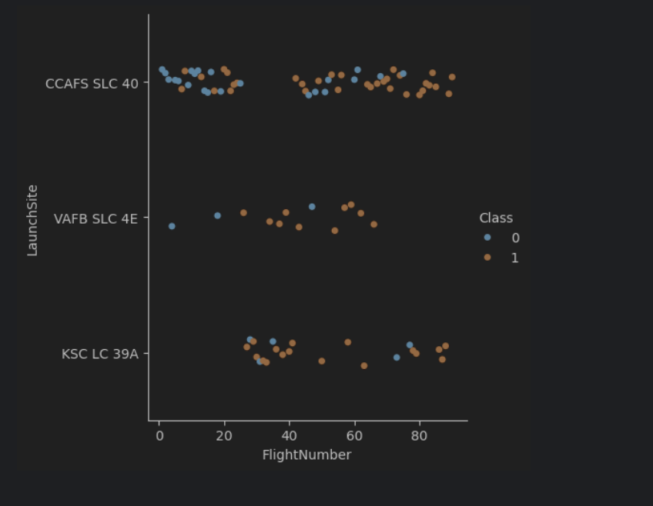
Flight Number vs. Launch Site
Here you can see that the ‘CCAFS SLC 40’ contained the highest amount of Flight Numbers and the most amount of Successful Launches

Slide 16
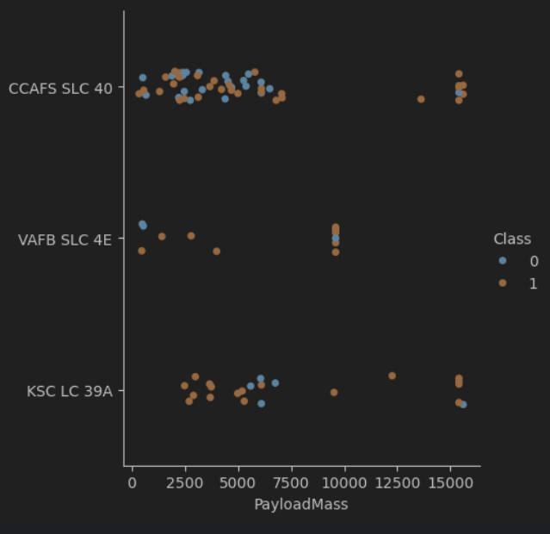
Payload vs. Launch Site
Here you can see the ‘CCAFS SLC 40 launch site launched with the highest Payload Mass

Slide 17
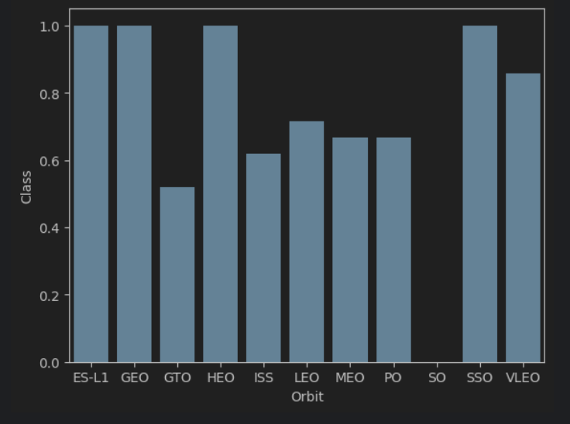
Success Rate vs. Orbit Type
Here you can that the ES-L!, GEO, Heo, and SSO orbit had the highest chance of success

Slide 18
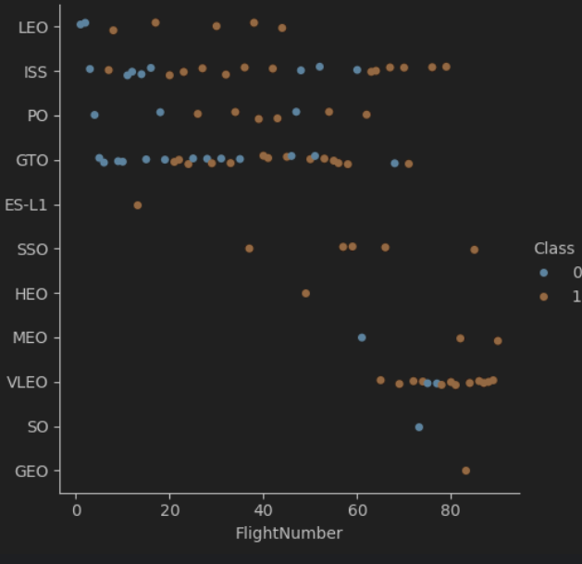
Flight Number vs. Orbit Type
There seems to be no relationship between Flight number and Orbit Type

Slide 19
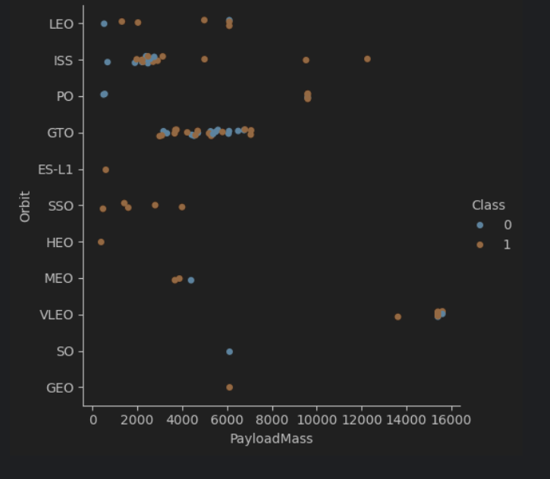
Payload vs. Orbit Type
You can see here that there doesn’t seem to be much relationship between Orbit type and Payload Mass

Slide 20
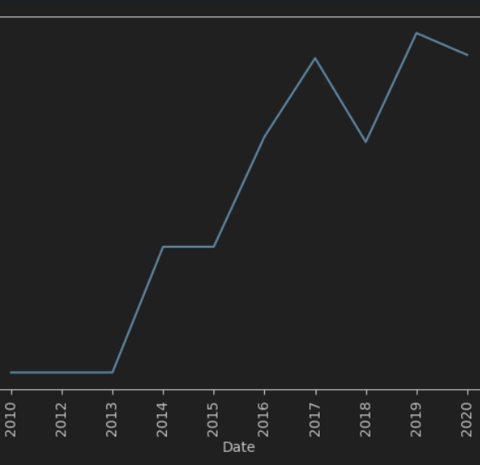
Launch Success Yearly Trend
As time progressed you can see that Launches had higher success rates

Slide 21
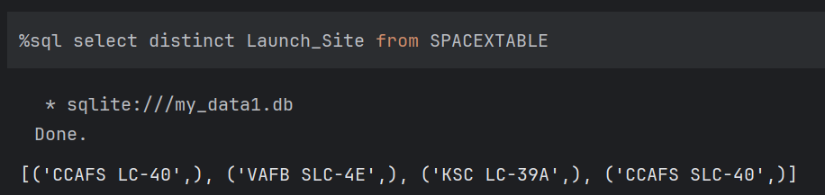
All Launch Site Names
When Querying the data with SQL, I was able to get a list of all Launch Site Names

Slide 22

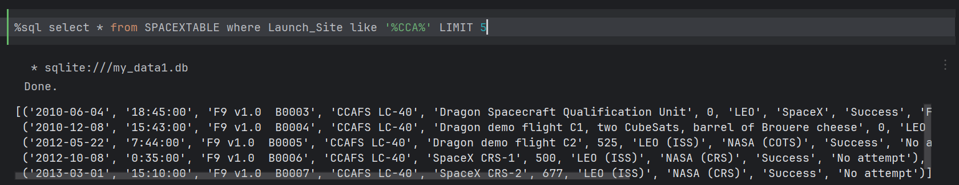
Launch Site Names Begin with 'CCA'
I was also able to use SQL to obtain all Launch Site names beginning with CCA

Slide 23
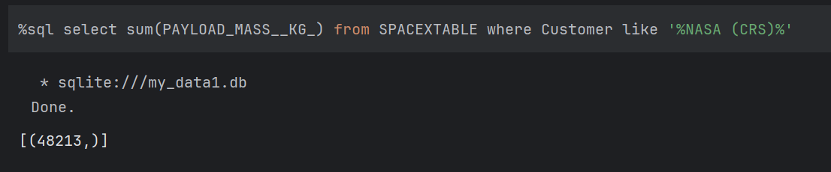
Total Payload Mass
Here is a query requesting the Total SUM of Payload Mass in the Data Frame

Slide 24
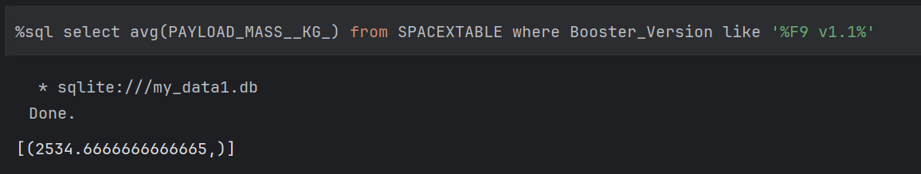
Average Payload Mass by F9 v1.1
This query returned the Average Payload Mass from Booster Version F9 v1.1

Slide 25
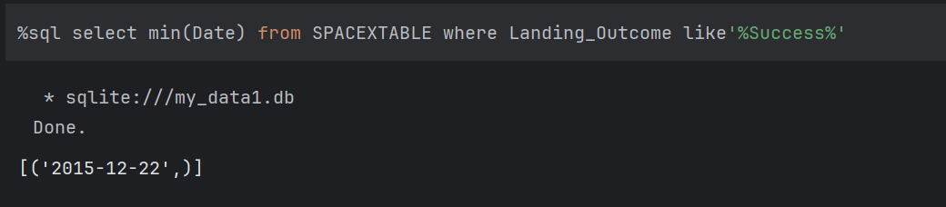
First Successful Ground Landing Date
Here how we can use SQL to display the First Successful Ground Landing Date

Slide 26
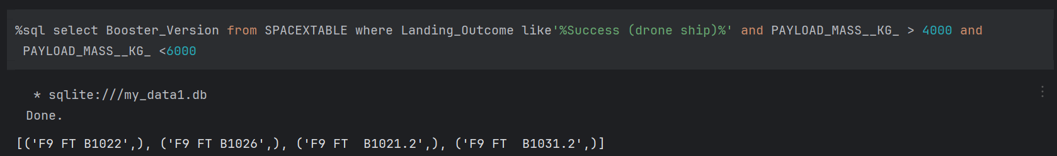
Successful Drone Ship Landing with Payload between 4000 and 6000
This query returns the Successful Drone Ship Landing with Payload between 4000 and 6000

Slide 27
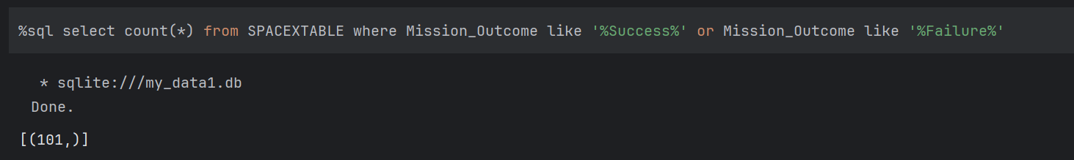
Total Number of Successful and Failure Mission Outcomes
Here I used the count(all) function to return the value of Mission Outcomes where there was a Success or Failure

Slide 28
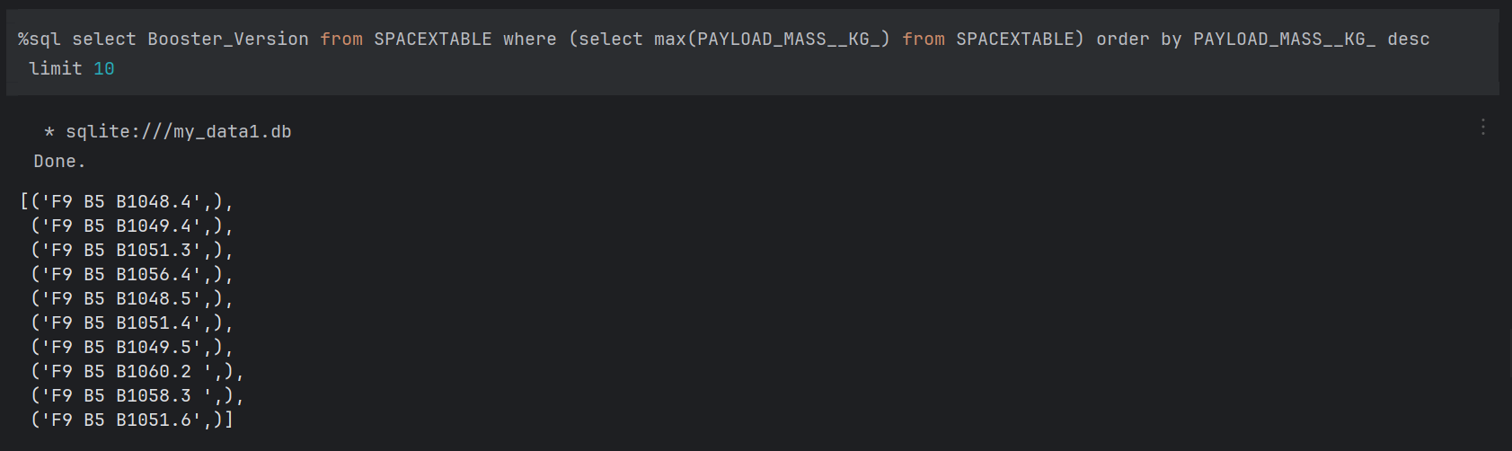
Boosters Carried Maximum Payload
I used SQL to return the Booster Versions from the SpaceX table where the maximum payload mass existed and listed the values after (up to 10)

Slide 29
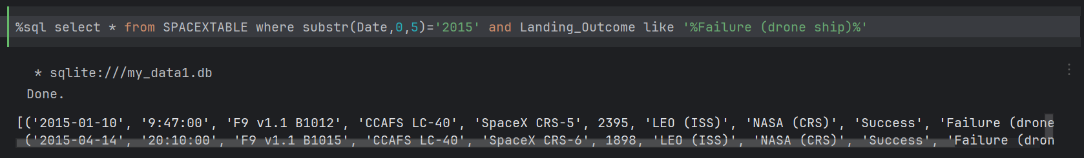
2015 Launch Records
This is how you can reurn all failed launch record from 2015

Slide 30
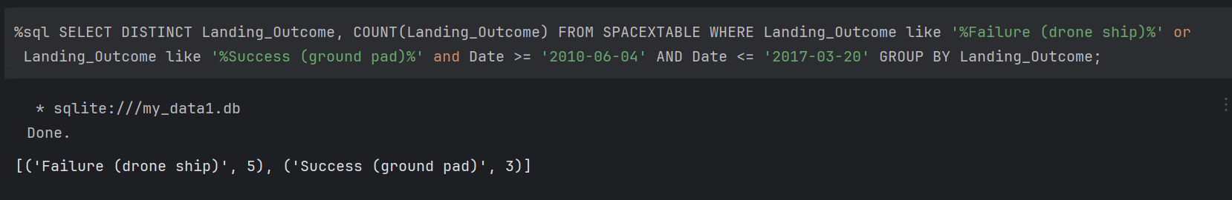
Rank Landing Outcomes Between 2010-06-04 and 2017-03-20
This is where I selected the Distinct Landing Outcomes and the count of Landing Outcomes from the spaceX table where the Landing Outcome that had Failure or Success and where the Dates were between 6-4-2010 and 3-20-2017

Slide 31

Section 3

Slide 32
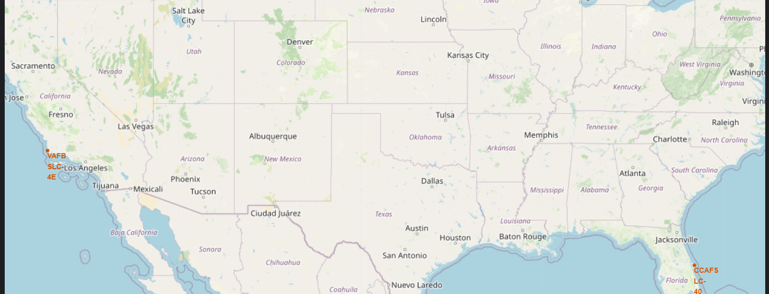
Interactive Map (Launch Site)
This map contains the Launch Sites for our rockets (They are clearly shown in Southern California and Central Florida on the East coast.

Slide 33
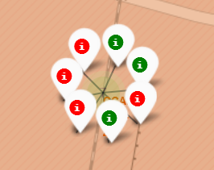
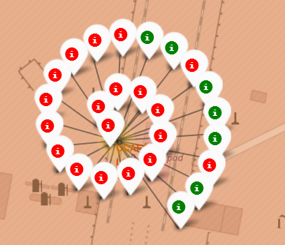
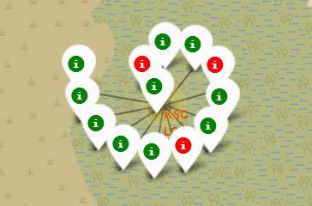
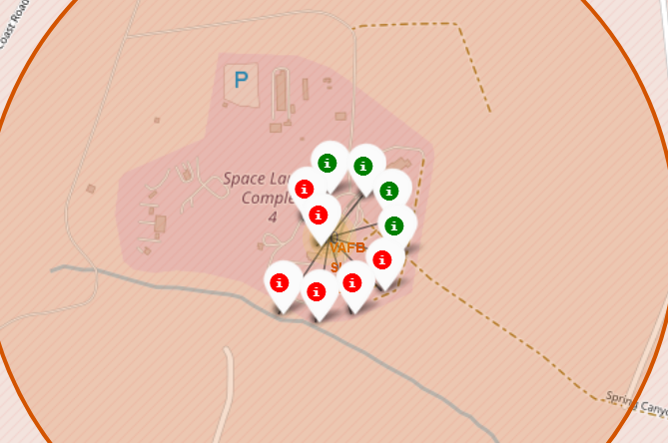
Which Launch Site Had the most Successful Launch Ratios?
Site CCAFS SFL-40
Site CCAFS LC-40
From our Interactive Map you can conclude that Site CCAFF LC-40 had the most Launches, but Site KSC LC-39A had the best Success Rate.
Site KSC LC-39A
Site VAFB SLC-4e
33

Slide 34
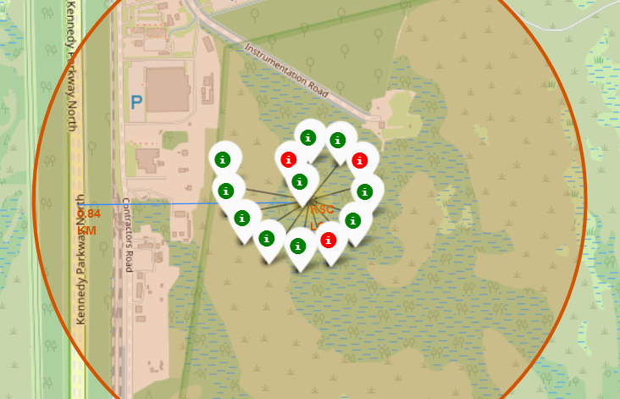
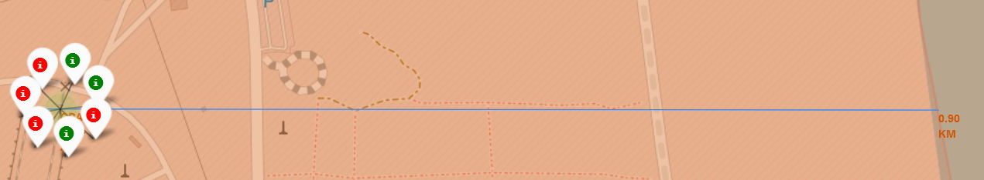
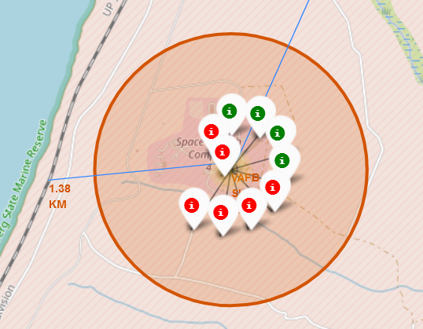
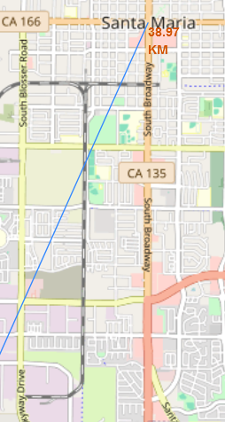
Are Launch Sites close to Cities, Coastlines, Railroads, or Highways
Launch Site CCAFS SLC -40 is .90 km from the Atlantic coastline
Launch Site KSC LC-37A is .84 KM from the nearest Highway
Site VAFB SLC-4e is 1.38 from the nearest railway and 38 Miles from Downtown Santa Maria
Launch sites are relatively close to Coastlines, Railroads, and Highways, but keep a clear distance from Cities.
34

Slide 35

Section 4

Slide 36
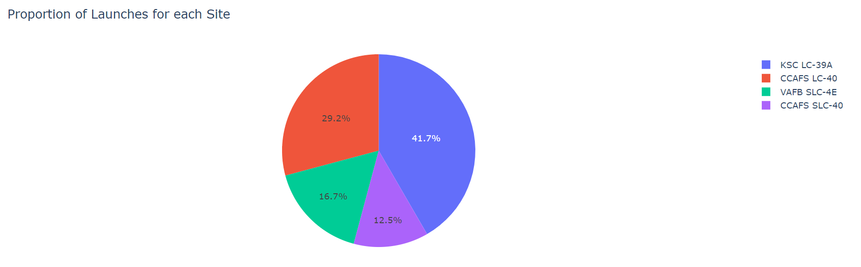
Which site have had the most Launches
Replace <Dashboard screenshot 1> title with an appropriate title
Show the screenshot of launch success count for all sites, in a piechart
Explain the important elements and findings on the screenshot
From this Pie chart you could determine that site KSC LC-39A have completed the most amount of launches
36

Slide 37
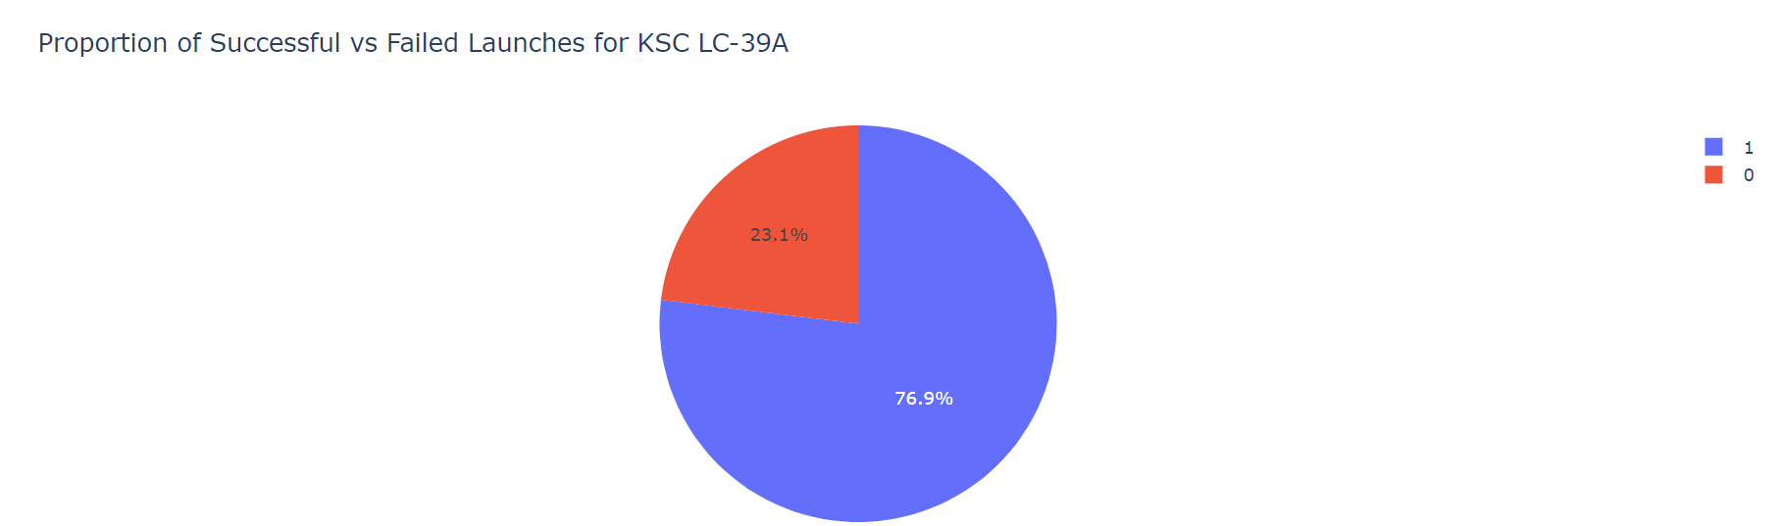
Which Launch Site had the most successful Rocket Launches?
As you can see. Site KSC LC-39A had the greatest proportion of Successful Rocket Launches.
37

Slide 38

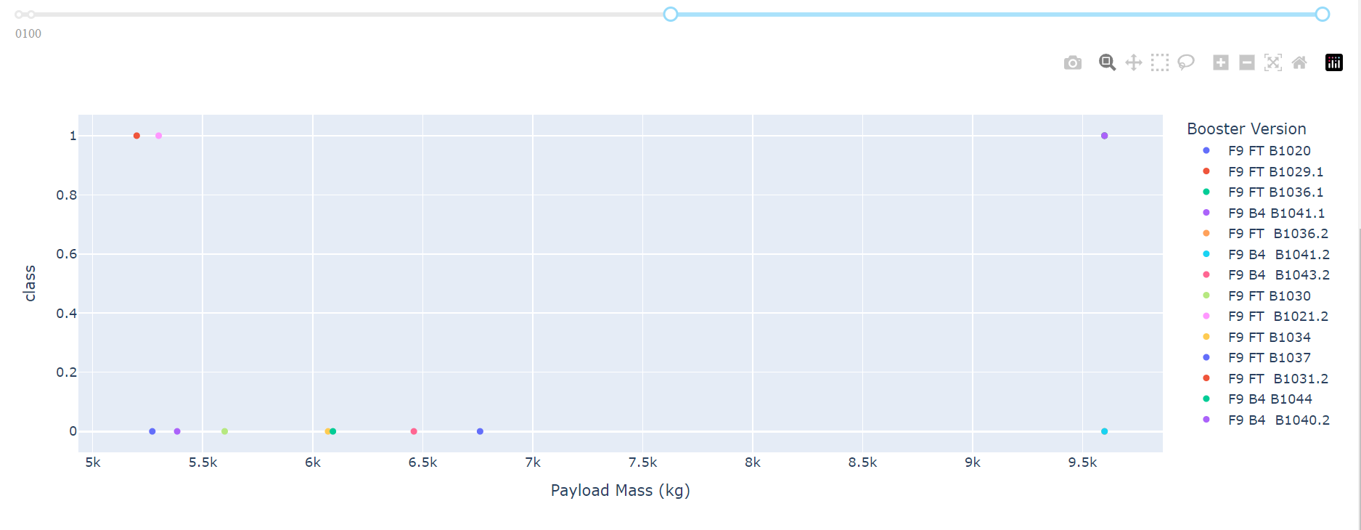
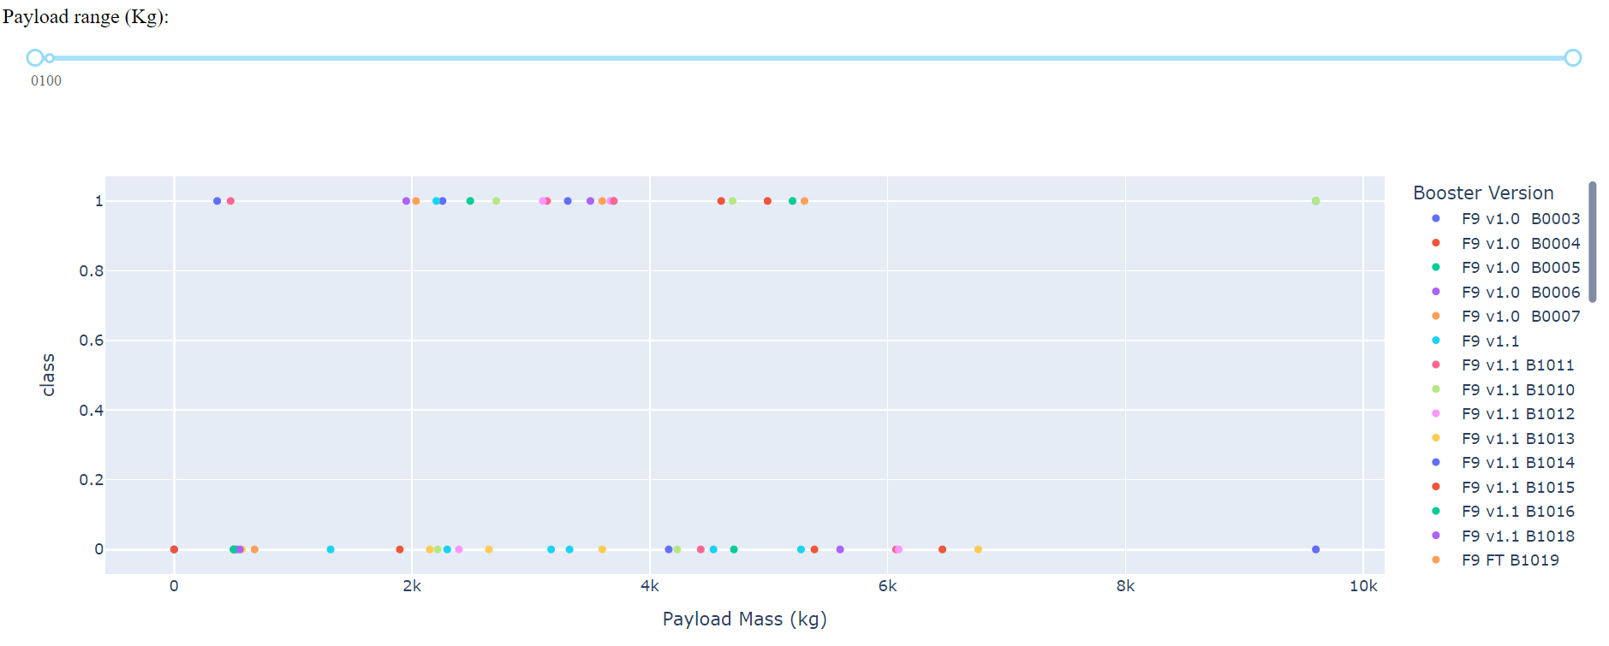
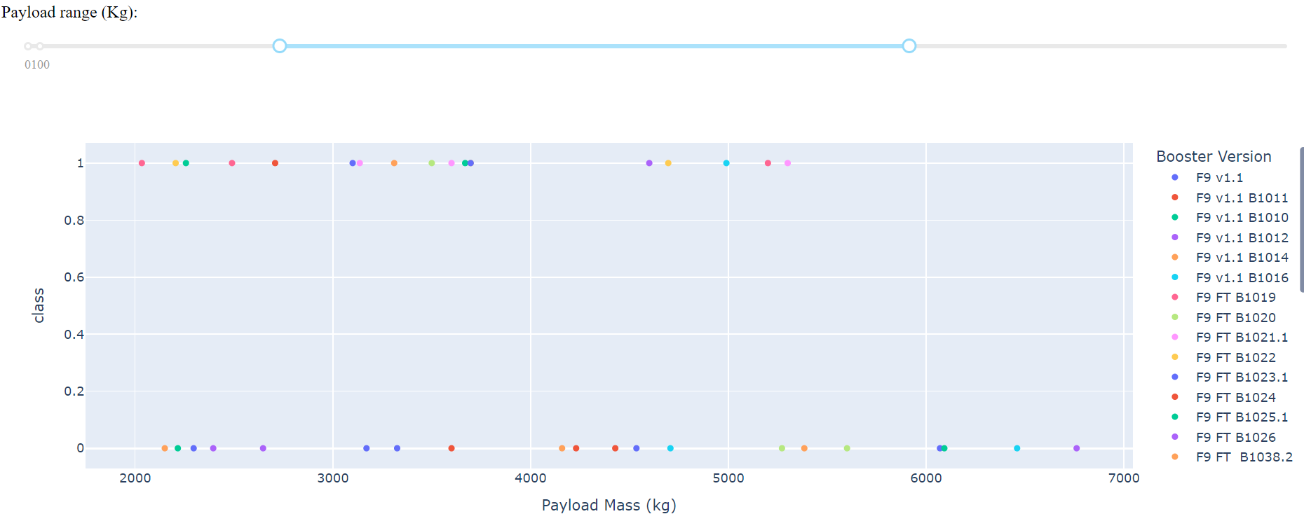
Does booster type matter? Which payload size work best?
Its looks like most successful missions contained payloads that were less than 6000 kg, but more than 1000 kg. It does not seem that booster variation does not matter.

Slide 39

Section 5

Slide 40
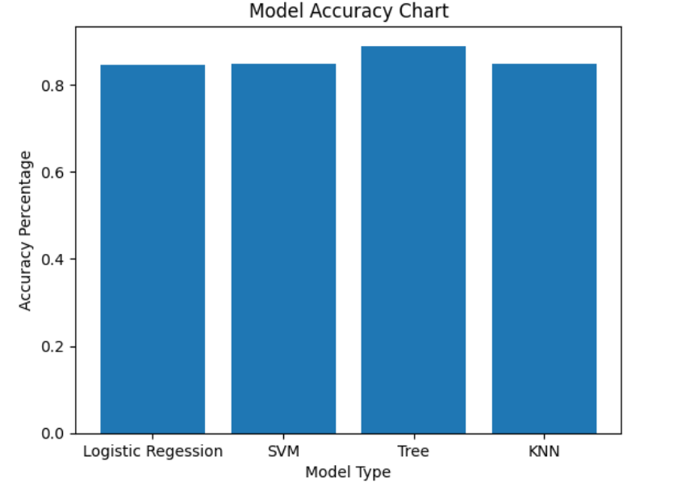
Classification Accuracy
While trying to make a prediction with the SpaceX
Data the Decision Tree Model showed the best
Accuracy with .89, but the Confusion Matrix showed 6
False positives.

Slide 41
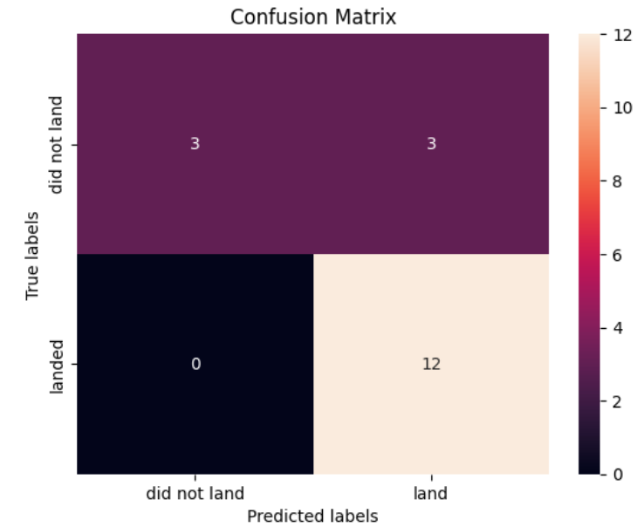
Confusion Matrix
When using Logistic Regression, K Nearest Neighbor, and Support Vector Machine models I got a high accuracy score, but I perpetually got 3 False positives with each Score.
I believe any of those models work best with the SpaceX data set.

Slide 42

Conclusions
‘CCAFS SLC 40’ contained the highest amount of Flight Numbers and the greatest number of Successful Launches but Launch Site KSC LC-39A had the greatest proportion of Successful Rocket Launches.
CCAFS SLC 40 launch site had to the greatest success with the highest Payload Mass
ES-L!, GEO, Heo, and SSO orbit types had the highest success rate
Besides a small dip in 2018, Success rate for all Launches Steadily increased
Launch Sites seems to be purposely built away from cities and are install closest to coastlines
Decision Tree displays the best accuracy with this data set, but poor confusion matrix
The best Models to use are Logistic Regression, Support Vector Machine, and K Nearest Neighbor.
This has been a lot of fun, thank you.

